Slide 1
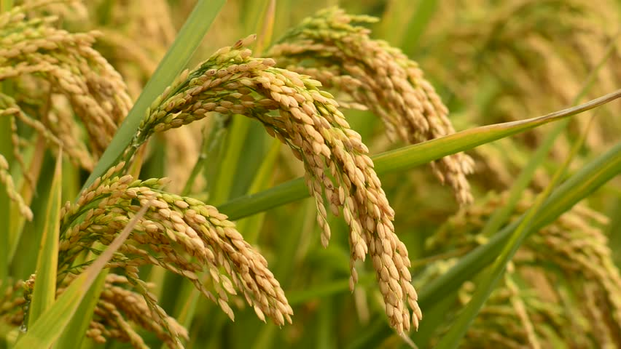
RICE
An Overview
by,
Haripriya N

Slide 2
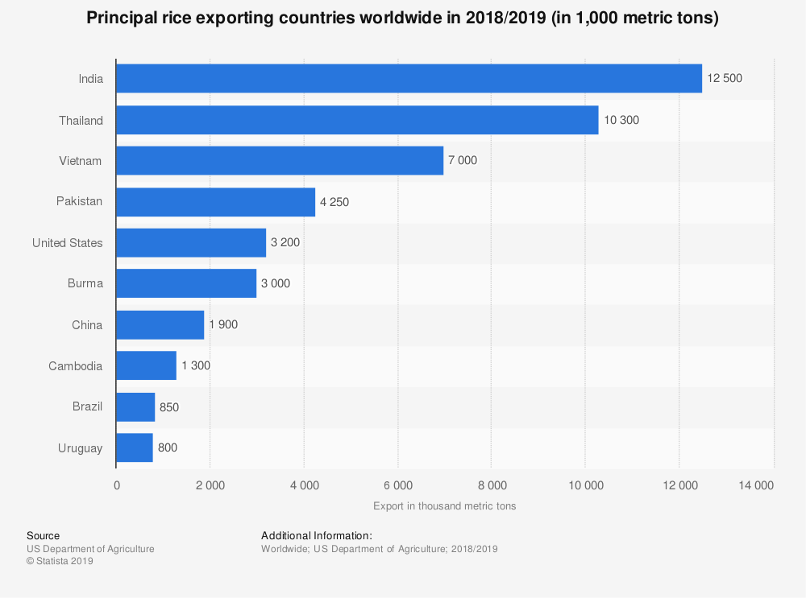
Introduction
Rice (Oryza Sativa) is among the top three majorly produced food crop of the world.
It is consumed as a staple food by more than half of the world’s population.
Asian farmers account to about 87% of rice production and India is the second largest producer(after China-35%) accounting to about 20% of world’s production. India is the largest exporter of rice in the world.
The species of rice : Genus Oryza includes 24 species of which 22 are wild, two are cultivated the remaining two are Oryza Sativa(Asian rice): 8,200 to 13,500 years old, Oryza Glaberrima(African rice): 2000 to 3000 years old.
Oryza Sativa is grouped into three species: (a) Indica, (b) Japonica, (c) Javanica
Hybrid varieties of Indica and Japonica is popularly used.

Slide 3
Required Environmental Conditions
Climatic Conditions:
Rice crop is grown in hot and humid climate, with regular annual rainfall.
Average temperature required for:
Total Growth period : 24°C
Sowing : 20°C - 22°C
Growth : 23°C - 25°C
Harvest : 25°C - 30°C
Temperature; 25°C and above, rainfall more than 100cm (avg 150 cm)
In areas of less rainfall (Punjab, Haryana, West UP), the land must be irrigated.
Temporal rainfall of 10 to 12 cm(except harvest month) must be maintained
Rice is a crop of tropical climate. However, it is also grown successfully in humid to sub-humid regions under subtropical and temperate climate.

Slide 4
Depending upon the climate and water rice is grown in all the three seasons, i.e. Kharif, Rabi and summer.
In northern and western India (J and K,Himachal Pradesh, Punjab, Haryana, Uttaranchal, Uttar Pradesh, Gujrat, Rajasthan, Maharashtra) grown mainly in Kharif.
In southern and eastern India it is grown round the year in three seasons with varying sowing time and periods.
Soils:
Paddy has adjusted to varied soil types therefore grown in wide range of soil,The major soil groups where rice is grown are riverine alluvium, red-yellow, red loamy, hill and sub-montane, Terai, laterite, coastal alluvium, red sandy, mixed red and black and medium and shallow black soils. Fertile riverine alluvial soil is best for rice cultivation.
Regions of river valley, flood plains, deltas, coastal plains are dominant in rice cultivation.
Clayey loam soil in monsoon land is considered to be the best for rice cultivation as water retention capacity of this soil is very high.

Slide 5
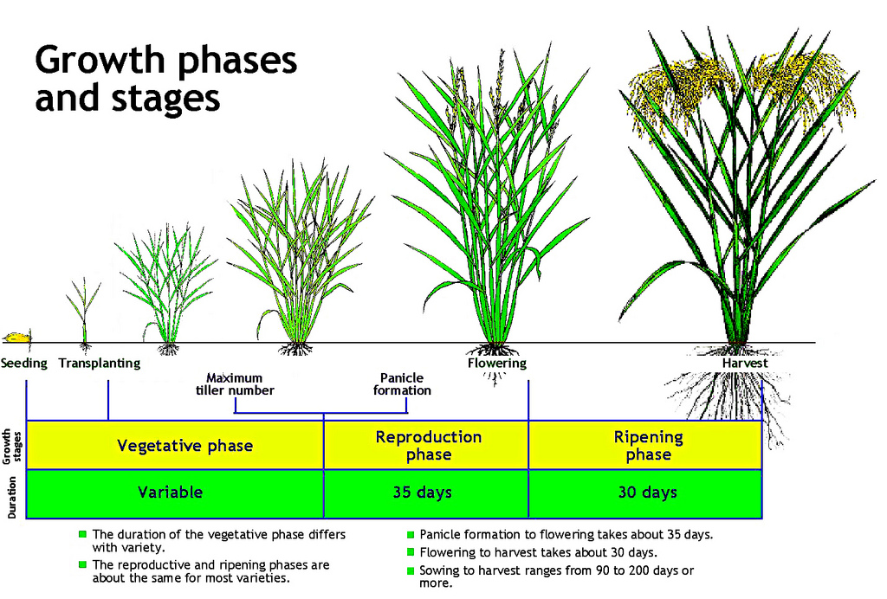

Slide 6
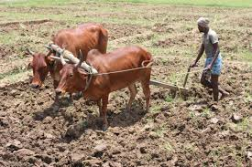
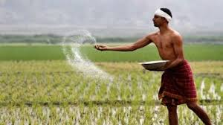
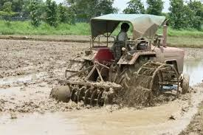
Cultivation Stages
Preparation of the land:
Plough the land at 10-20 cm length, this helps in removal of weeds by exposing their roots, break down blocky structures and also turns over the upper layer of the soil.
Irrigate the field with 2-3 cm of water for 10-14 days. This softens the soil and also decomposes the weeds and unwanted organic material.
Fertilizer is added to the field after or along with irrigation (⅓ Nitrogen, 1 Phosphorous, 1 Potash)
Puddle the field is done to avoid percolation loss of water and for effective weed control

Slide 7
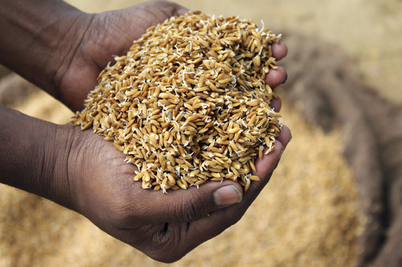
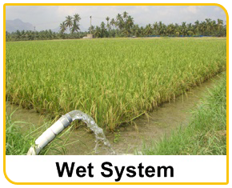
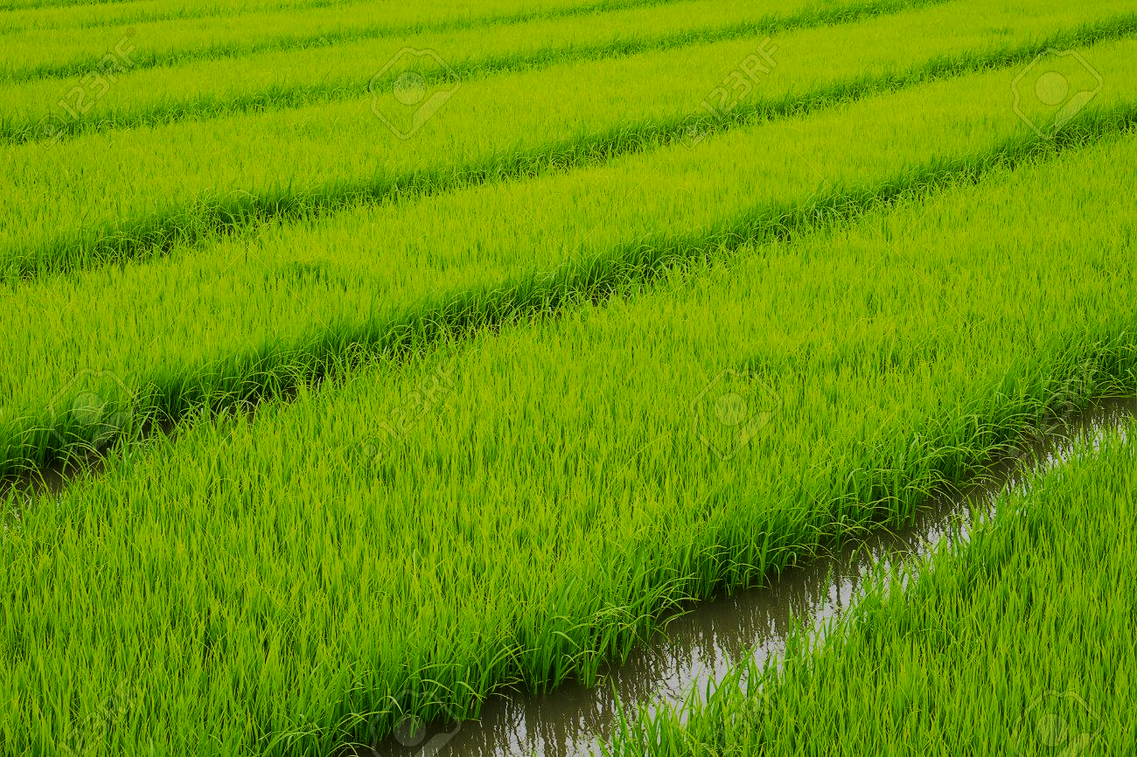
2. Seed Sowing and Raising Nursery:
Seeds are soaked for 24 hrs in fungicide solution to prevent soil borne diseases and give resistance to seeds. Dry them n shade for sowing.
Nursery bed is raised by applying fine layer of manure and sow the seeds (25kg/acre) , spread sparsely
Irrigation is started on the 5th day of sowing and continue upto 7th day to a depth of 5 cm.
Keep the 5cm level for good growth and to avoid weeds.
Transplantation of the seedlings is done on the 20-25th day of sowing.

Slide 8
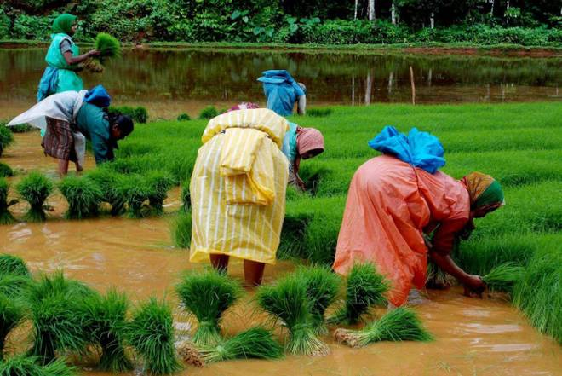
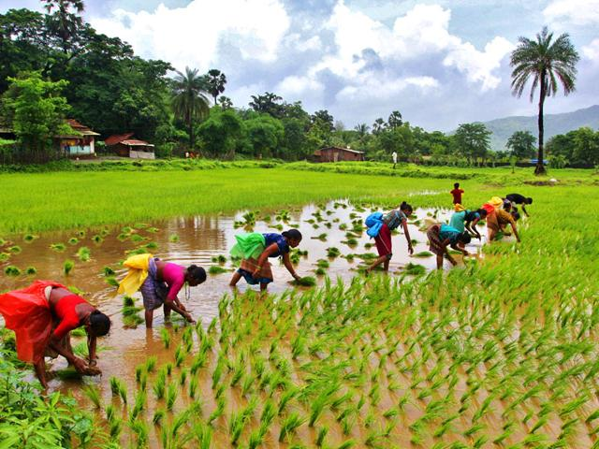
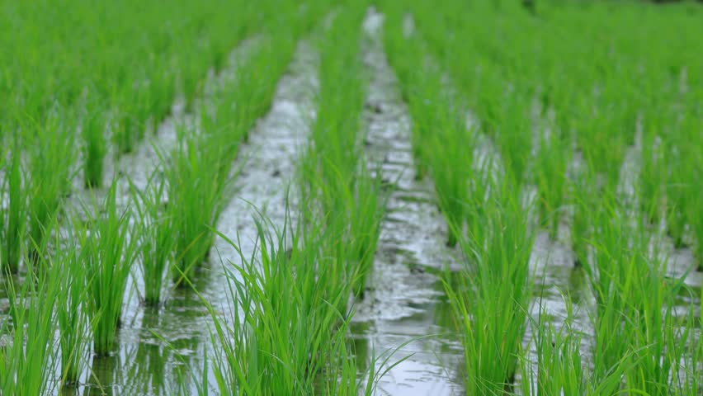
3. Transplantation and Flood Irrigation:
Transplantation is done after removing, bundling the seedlings and planting them in a puddled field with optimal spacing (20-22cm), this is to facilitate enough nutrition and water for crop growth.
Chopping leaf tips before transpling will reduce disease development.
Flood Irrigation (continuous flooding of water) is the best growth environment for rice crops.
Levels of water, 3cm after transplantation, the levels should gradually increase to 5-10cm with increase in plant height, these levels must be maintained until 10-15 days before harvesting.

Slide 9
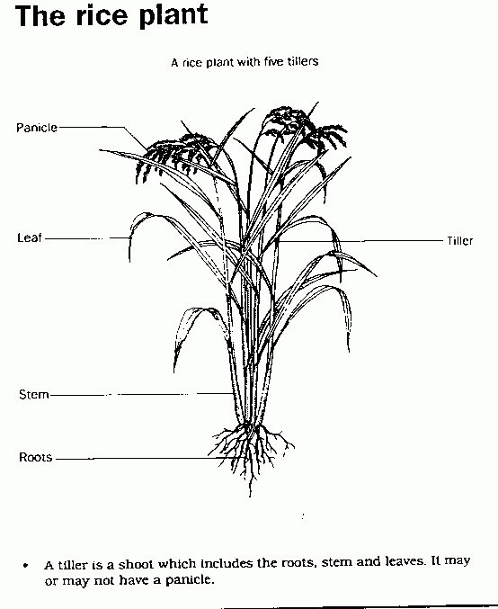
Basic Parts of Rice Crop
Panicle; a loose branching cluster of flowers
Tiller; Specialized grain-bearing branch
Leaf Sheath; A structure at the base of a leaf
Node and internode; Nodes are the segments in Culm and internodes appears between segments

Slide 10
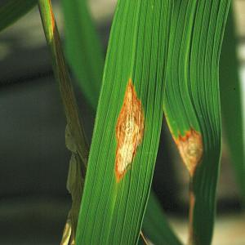
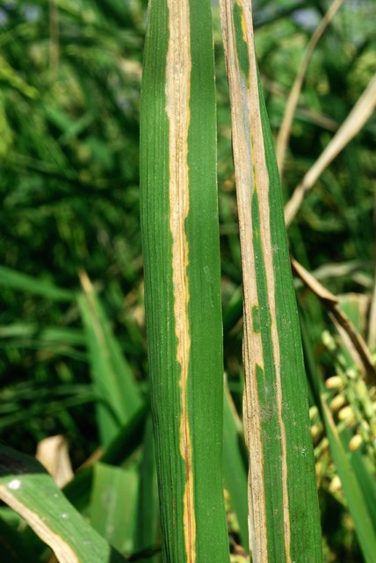
Diseases
Name | Symptom | Pathogen | Favourable Conditions | Stage and part Affected | Image
Blast | Small specks on the leaf later enlarges into spindle shaped spots Several spots combined looks like big irregular patches | Pyricularia Oryzae | High relative humidity free moisture on the plant tissue surface temperatures around 28º C, Cooler or warmer Disease slow down the process | Stage: All stages Part affected: Leaf Collar Nodal Region Neck All parts
Bacterial Leaf Blight | Seedling kresek Yellowish stripes on leaf blades/ leaf tips Milky bacterial ooze Lesions turn yellow to white when disease advances | Xanthomonas oryzae | Warm temperature (25-30° C), high humidity, rain and deep water. Severe winds, over fertilization | Stage: From Seedling stage Part affected: Leaf tips Leaf Margins

Slide 11
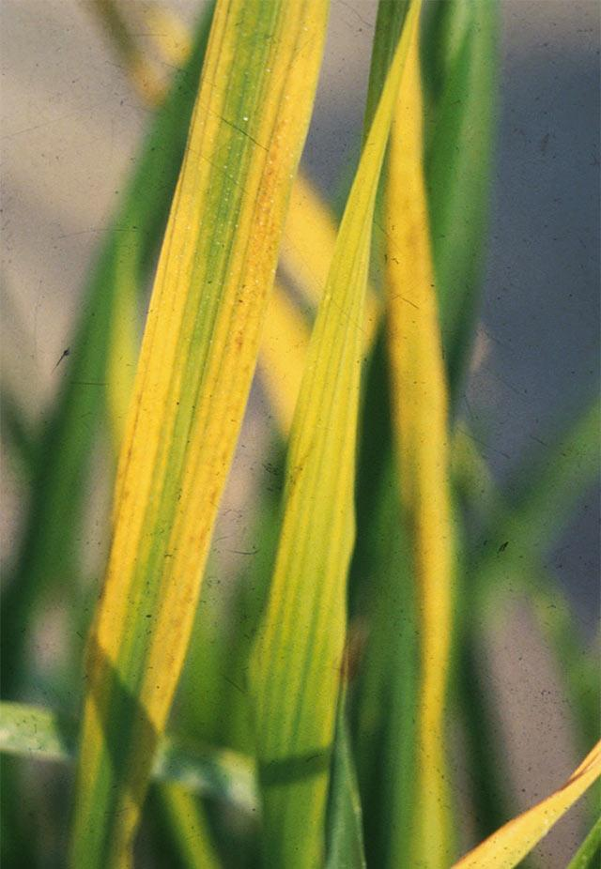
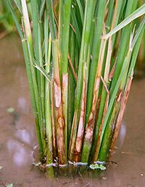
Name | Symptom | Pathogen | Favourable Conditions | Stage and part Affected | Image
Rice tungro | Stunning/reduced tillering Yellow/Orange yellow leaves starts from leaf tips. May have rust spots, delayed flowering, most pinacle have partly filled grains. | Rice tungro virus | Occurs in some wild varieties, caused by Green leafhoppers which survive in rainfed and irrigated wetland environments | Stage: All stages Part affected: Leaf tips Leaf Blade Lower Leaf Neck Mostly on lateral leaves.
Sheath Blight | Seedling kresek Yellowish stripes on leaf blades/ leaf tips Milky bacterial ooze Lesions turn yellow to white when disease advances | Xanthomonas oryzae | high temperature (28−32°C) high levels of nitrogen fertilizer relative humidity of crop canopy from 85−100%. | Stage: from Vegetative stage Part affected: Leaves Young tillers

Slide 12
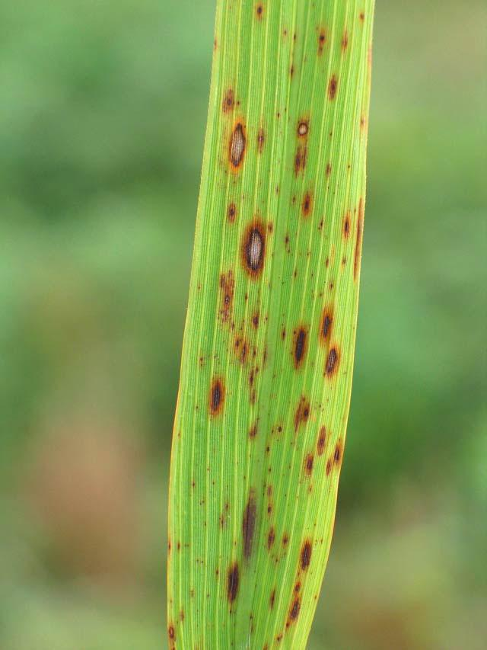
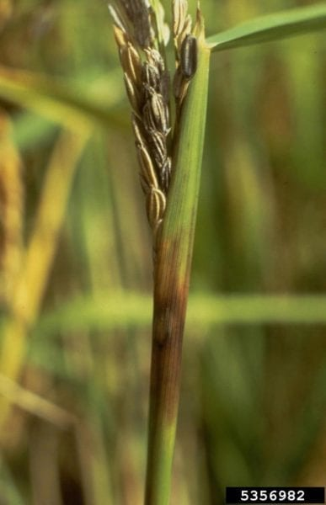
Name | Symptom | Pathogen | Favourable Conditions | Stage and part Affected | Image
Brown Spot | Causes blight of seedlings Spots in Leaf (brown, round and oval spots) Black or brown spots on glumes infection on panicle neck | Helminthosporium oryzae | High relative humidity (86−100%) Temperature between 16 and 36°C common in unflooded and nutrient-deficient soil, or Soils that accumulate toxic substances. | Stage: from reproduction Part affected: Leaf Seed(glumes) Seedling Panicle neck
Sheath Rot | Irregular spots or lesions with dark reddish brown margin, grey centre. Irregular Spots, Discoloration on Sheaths Panicles remain within the Sheath Rotten of Flag Leaf Sheath | Sarocladium oryzae | Rainfed rice ecosystems Prevalent during wet than dry seasons. Increases with increase in plant density. Presence of injuries by insects such as Stem borers High Nitrogen fertilizer application | Stage: from Vegetative stage Part affected: Flag leaf sheath Young panicle Florets

Slide 13
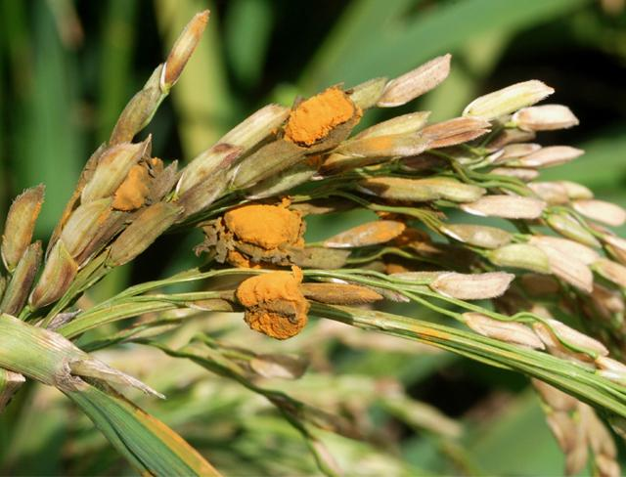
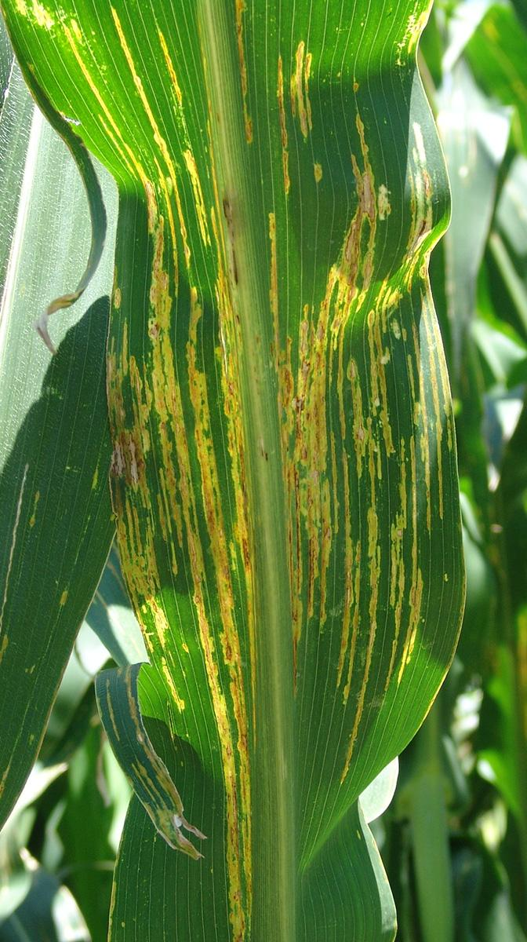
Name | Symptom | Pathogen | Favourable Conditions | Stage and part Affected | Image
False Smut | Single grain transforms to yellow fruiting bodies, Velvety spores in floral parts Immature spores are yellowish, smooth and flattened Mature spores are yellowish green and greenish black | Ustilaginoidea virens | Low temperature (20°C) High relative humidity (>92%) Moderate rainfall with intermittent clear and drizzling weather during flowering. Prevalent in seasons favorable for good growth and high yields. | Stage: from reproduction phase Part affected: Flower (all parts) Grain
Leaf streak | Initially, small, dark green, water soaked translucent streaks on veins from tillering to booting stage Lesions turn brown and bacteria ooze out under humid weather. | Xanthomonas oryzae | Occurs in areas with high temperature and high humidity. It is transmitted through seeds and infected stubbles to the next planting season. | Stage: from Vegetative stage Part affected: Leaf

Slide 14
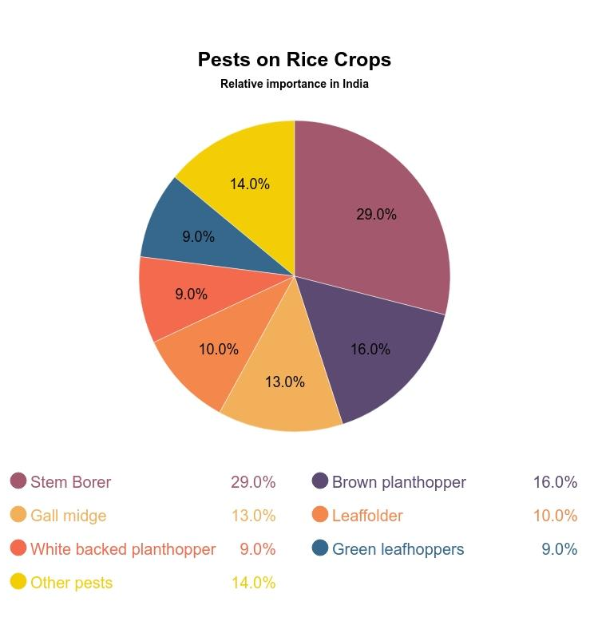
Pests
Farmers lose an estimated average of more than 37% of their rice crop to pests and diseases, pest contribute to about 20% (varying) every year. Some of the important Pests are mentioned in this chart.

Slide 15
Reference
Introduction: http://ricepedia.org/culture/history-of-rice-cultivation
Climate and soil: https://www.ikisan.com/ka-rice-soils-and-climate.html, https://en.wikipedia.org/wiki/Rice_production_in_India, https://farmer.gov.in/cropstaticsrice.aspx
Growth stages of rice: https://nature-and-farming.blogspot.com/2014/10/rice-production-chapter-2-growth-stages.html
Cultivation stages: https://www.youtube.com/watch?v=mDE-Xd2J6aA,
Diseases: http://www.knowledgebank.irri.org/step-by-step-production/growth/pests-and-diseases/diseases, http://agritech.tnau.ac.in/crop_protection/crop_prot_crop%20diseases_cereals_paddy.html.
Pests: http://www.knowledgebank.irri.org/step-by-step-production/growth/pests-and-diseases

Slide 16
Thank You

